Slide 1



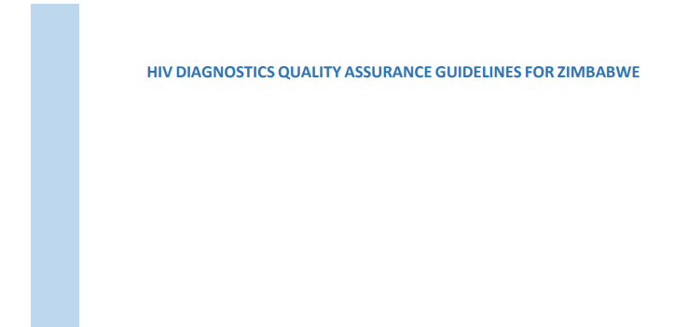


Zimbabwe HIV Diagnostic Quality Assurance Framework

Slide 2

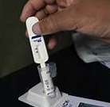


Zimbabwe quality assurance framework for HIV diagnosis
HIV rapid testing
HIV self-testing
Early infant diagnosis (EID) of HIV using conventional laboratory equipment
Point-of care (POC) technologies,
In 2020 Zimbabwe revised the HIV diagnostics guidelines and consolidated all the activities for a quality assured HIV testing and related laboratory services that included:

Slide 3
Quality Assurance HIV Technical Working group
Monitoring and evaluating, the CQI i.e. IQC, EQA, Accreditation and National Certification.
05
Ensuring implementation of HIV continuous quality improvement.
04
Ensuring Staff have appropriate skills and competencies.
03
Ensure availability of resources (HRH, equipment, reagents and consumables).
02
Establishment of the HIV Technical Working group that coordinates the QA program.
.
01

Slide 4

QA Strategy Roles and Responsibilities
Laboratory services stakeholders
Program stakeholders
The HIV Testing Quality Assurance TWG was formed in 2017 and meets quarterly to provide leadership in the implementation of quality assurance for HIV testing activities in Zimbabwe.
AIDS AND TB UNIT
DLS
Coordinating Testing Services Program
07
01
Coordinating laboratory testing and Point of Care testing quality improvements. Development of HIV Diagnostics
06
02
MLcSCZ
Training, Certification and Regulation of Testers
NMRL
Provide Proficiency Testing and coordination of IQC, Certification of Testers, Post Market Surveillance Testing.
05
03
MCAZ
Regulation of Invitro Diagnostics
04
National Pharmaceutical COMPANIES LLU
ZINQAP
Logistic Supply Management of Commodities
Provide EQA Proficiency testing schemes.

Slide 5
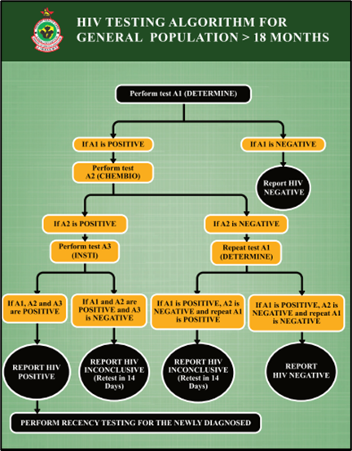
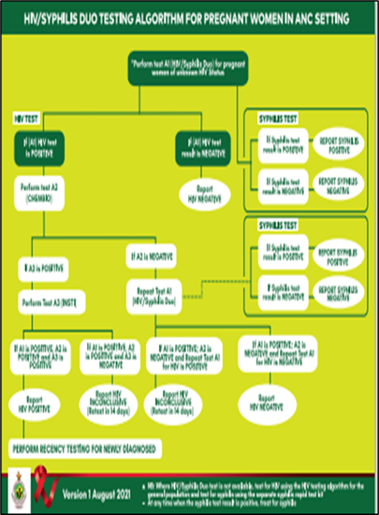
National Rapid HIV testing algorithms
Pregnant women in ANC setting
General Population

Slide 6
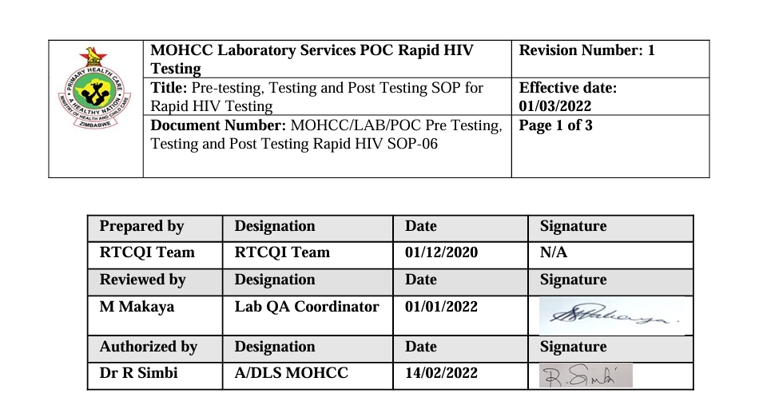
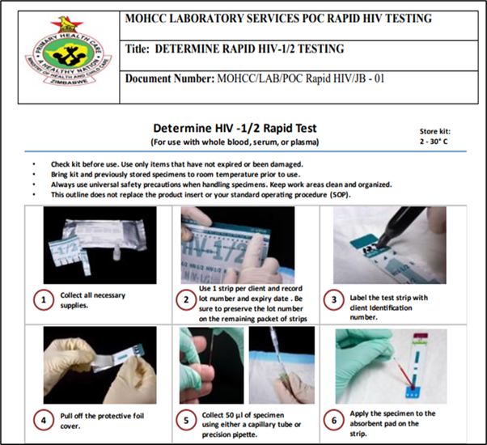
National Rapid HIV testing SOPS and job aids
Job aid
SOP

Slide 7


Rapid HIV trainings
National Rapid HIV trainings for testers are done through MLCSCZ and subsequent refresher trainings are done on site.
Currently over 7000 testers have been trained nationally.

Slide 8
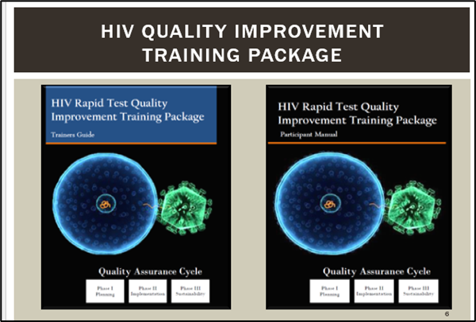
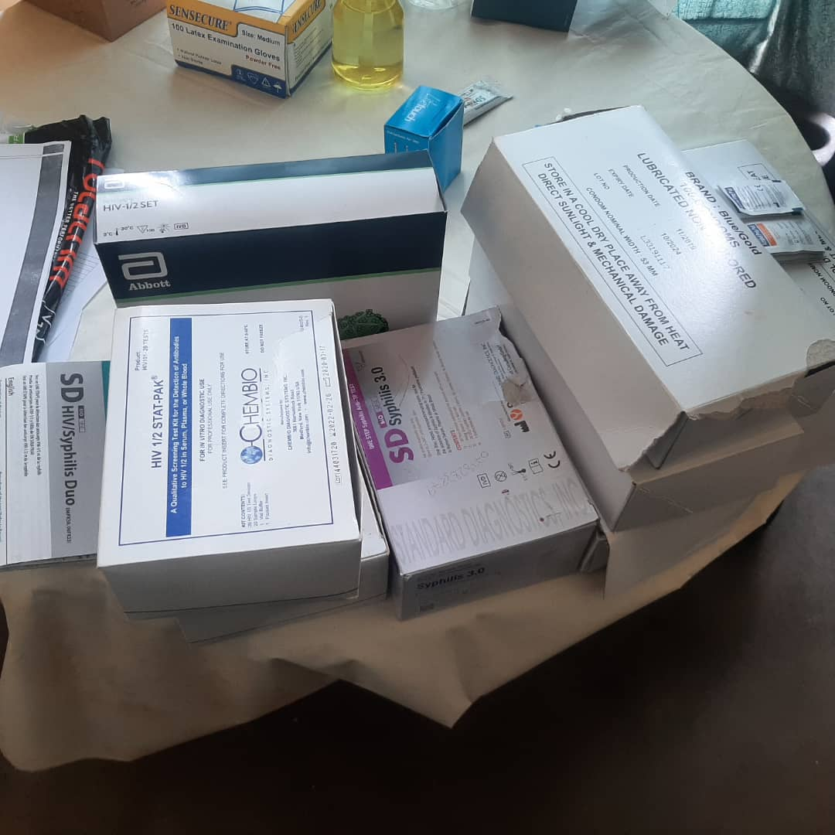
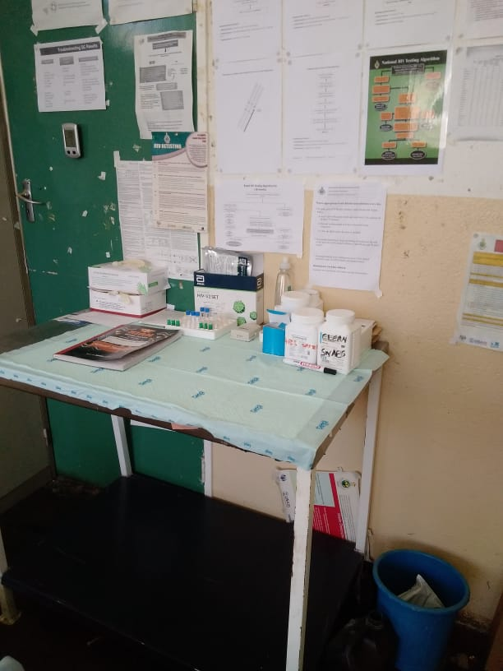
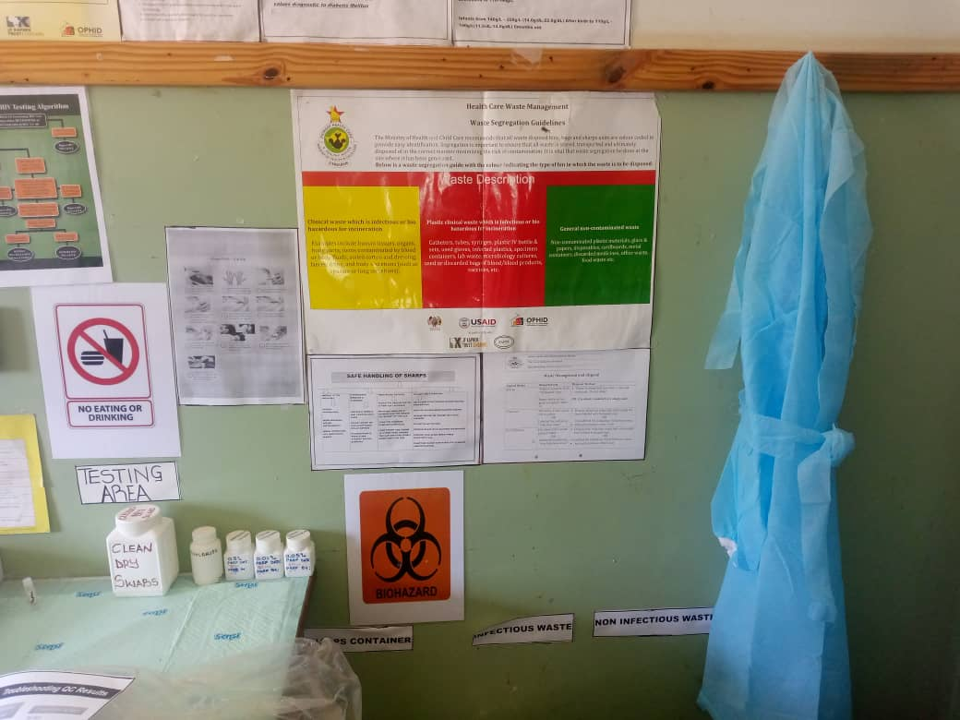
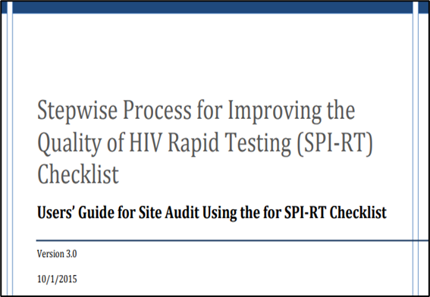
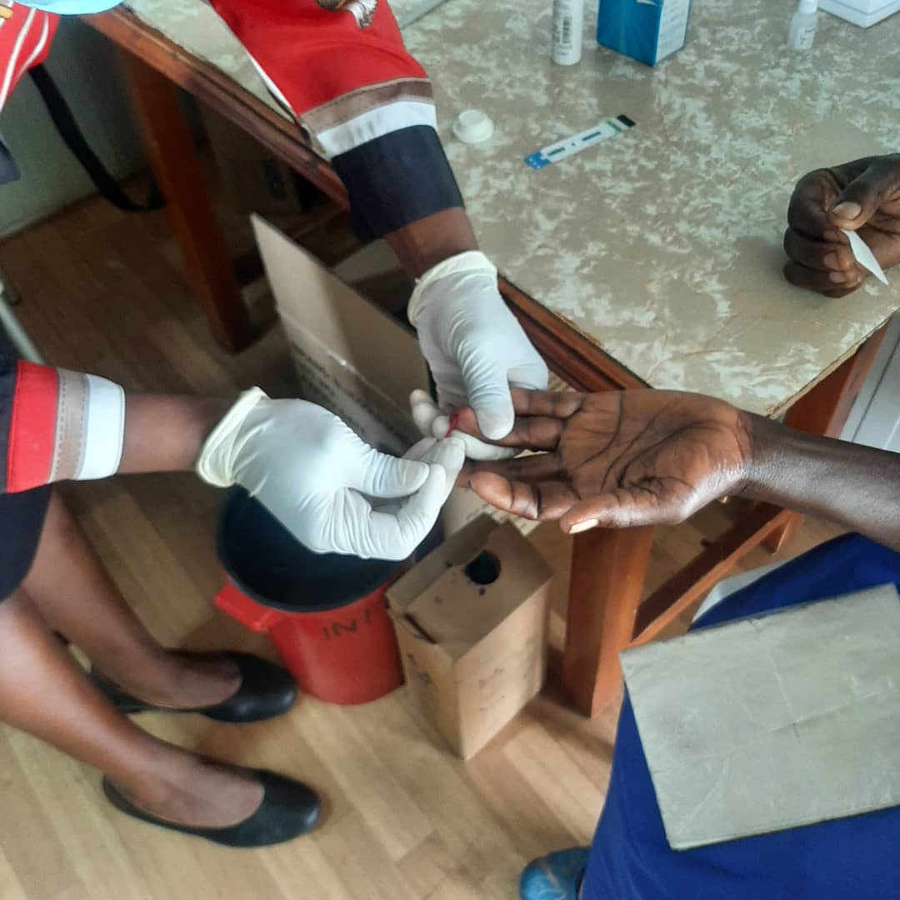
RTCQI

Slide 9
Rapid HIV Testing Competency Assessments
Rapid HIV testers are deemed competent after passing a panel of 6 PT samples provided by NMRL and ZINQAP.
Currently over 6000 testers participate in that scheme.

Slide 10
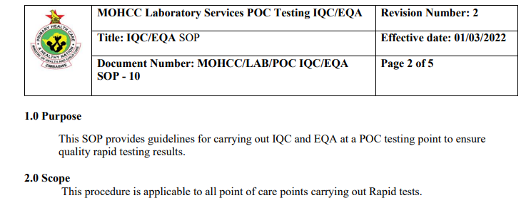
IQC AND EQA experience
Internal Quality Control | Procedure for preparation developed at National level and standardized. Disseminated at trained through the Sub-National Level
External Quality Control | Provided through the NMRL and ZINQAP. Corrective actions provided virtually and physically.

Slide 11
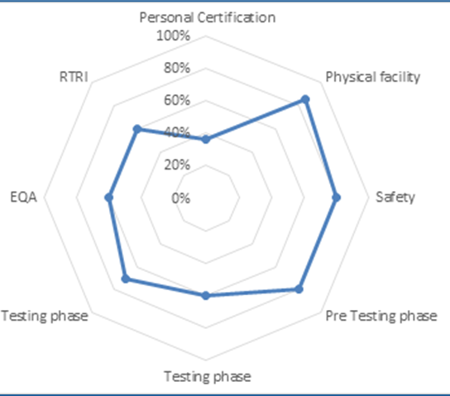
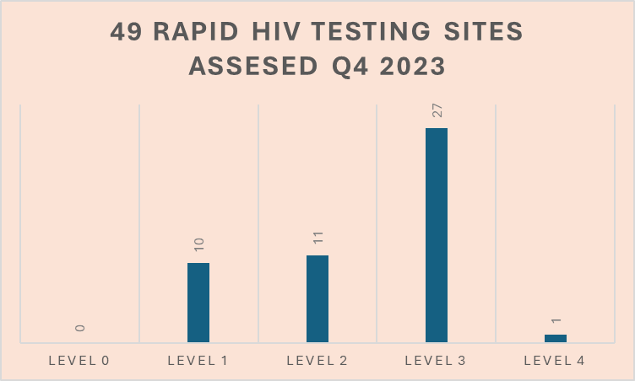
Implementation Experience: Site Assessments using SPI-RRT Checklist

Slide 12
Activity | Lessons Learnt
National Policies, Procedures and Job Aids | Using central online document repository to share documents with testing points and testers. Easier to manage and review.
Internal Quality Control | Central preparation of IQC samples at NMRL improves quality of samples.
External Quality Control | EQA PT scheme done through NMRL and MoHCC structures is sustainable and efficient to do corrective actions and improvements.
Tester Training, Competency and Certification | Capacitating POCT sites to do refresher training and competency assessment more sustainable and efficient.
Post Market Surveillance | Decentralizing surveillance process to the Provincial/District Laboratories is more sustainable.
Lessons learnt

Slide 13


Thank you

